Slide 1
Chiba Campaign 2021 Daily Report (07/26~) : Tropospheric NO₂ from TROPOMI and 4AZ-MAXDOAS 2021/08/02
Saito Hikaru(齊藤 輝)

Slide 2
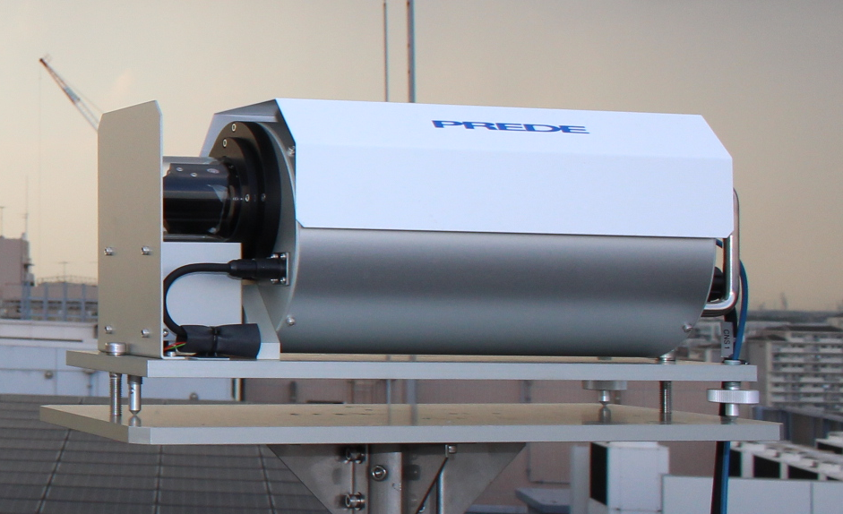
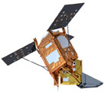
Tropospheric NO₂ column density data
4AZ-MAXDOAS (Ground-based)
Plot…
・All measurements
・Daily average
TROPOMI (TROPOspheric Monitoring Instrument) (Satellite-based)
Plot…
・Daily 0.2°×0.2° average, cloud<0.2 data
・Standard Deviation in pixels of 1-day data
1995
2002
2004
20km

Slide 3
07/26

